Slide 1

Risk Masterclass
November 2024
CORPORATE GOVERNANCE INSTITUTE

Slide 2

danger opportunity

Slide 3


Slide 4


Slide 5
Masterclass objectives
By the end of the session, participants will:
have enhanced their understanding of their roles in relation to risk
appreciate the importance of assessing the relative maturity of risk management practices
have learned practical questions to ask at the Board table
feel more confident about their ability to challenge management about risk

Slide 6
What do you want to get out of this Masterclass?
Provide a brief description in the Chat-box

Slide 7
Agenda
Case Study
A recap on the basics
Global Insights / Personal Insights
Practical Questions

Slide 8
Case Study
1.

Slide 9
Carol is a project manager with a long and successful track record, especially in overseeing implementation of complex IT projects. She was delighted when she applied and was accepted to join the board of a financial services company.
The company has transparency and accountability as core values and all the senior executive team attend the whole board meeting to foster these values and demonstrate that the board is committed to them.
At the most recent meeting, Carol asked a series of questions about a project that she believes could be at risk of delays, error and cost overruns (especially in relation to cyber threats). She felt that the CEO was not fully alert to the potential scale of the issues, and that the executive responsible, who was at the meeting, was evasive in answering. The board, however, took notice and asked for a deep dive into the project at their meeting after next.
The executive responsible for the project feels deeply offended and believes that Carol has defamed him and questioned his competence in front of his peers and manager. He has asked the Inhouse General Counsel for advice on how to take legal action against Carol.
The Chair has been informed and has called Carol, asking her to propose a way to resolve this situation. Suggest a small number of key actions to resolve the situation.
(Hint: consider this problem at a number of levels of concern)

Slide 10
A recap on the basics
2.

Slide 11
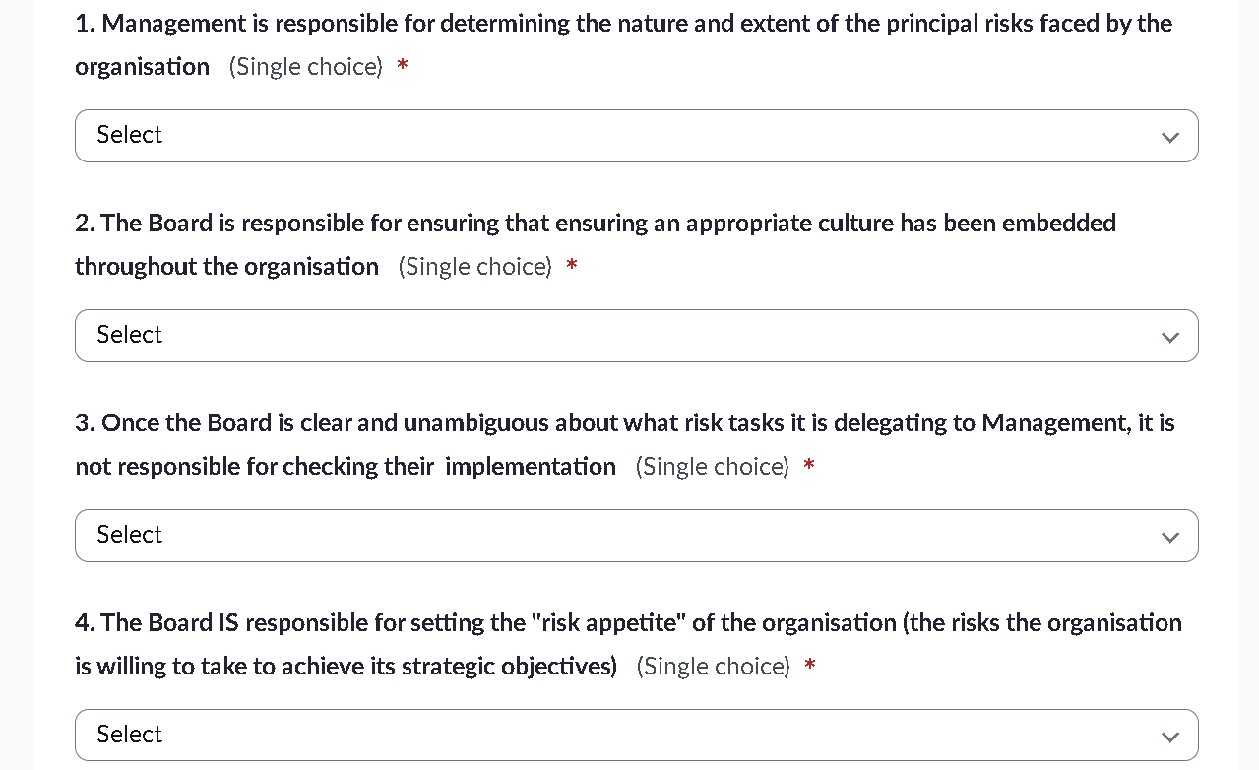
The Board’s responsibilities for risk (v. Management) ???

Slide 12
The Board’s responsibilities for risk (v. Management) ???
ensuring the design and implementation of appropriate risk management and internal control systems that identify the risks facing the company and enable the board to make a robust assessment of the principal risks;
determining the nature and extent of the principal risks faced and those risks which the organisation is willing to take in achieving its strategic objectives (determining its “risk appetite”);
ensuring that appropriate culture and reward systems have been embedded throughout the organisation;
agreeing how the principal risks should be managed or mitigated to reduce the likelihood of their incidence or their impact;
monitoring and reviewing the risk management and internal control systems, and the management’s process of monitoring and reviewing, and satisfying itself that they are functioning effectively and that corrective action is being taken where necessary; and
ensuring sound internal and external information and communication processes and taking responsibility for external communication on risk management and internal control.
Source: Corporate Governance Code

Slide 13
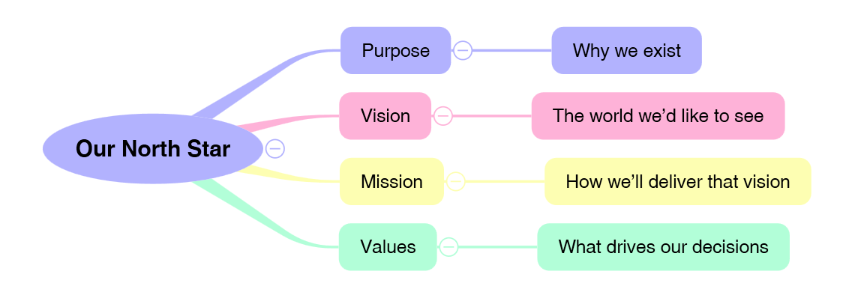
Where does Risk fit in?
Purpose/Vision /Mission/Values
Strategic Plan
Strategic Outcomes
Satisfied Stakeholders
Delighted Customers
VFM Processes
Motivated Workforce
Operational Plans
Personal Plans

Slide 14
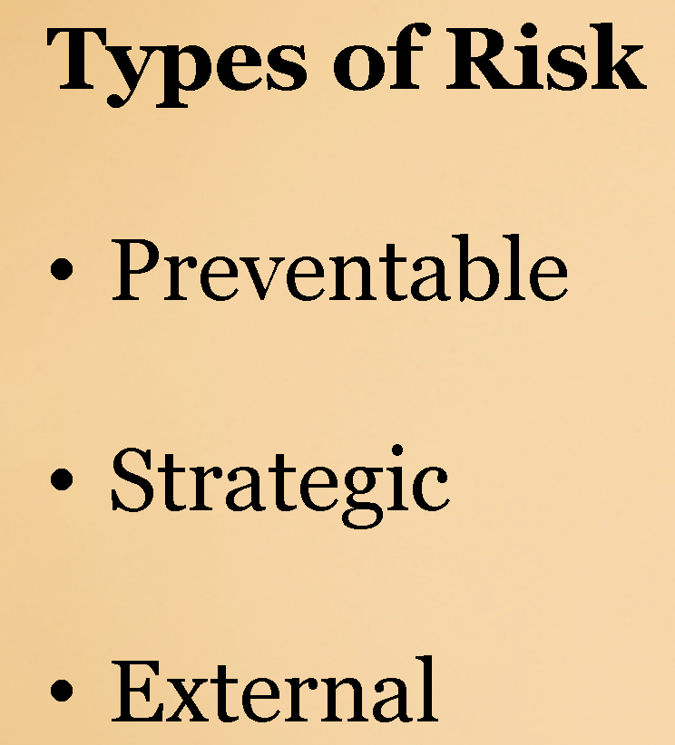
Where does Risk fit in?
V U L N E R A B I L I T I E S
Purpose/Vision /Mission/Values
HAZARDS
Strategic Plan
Strategic Outcomes
Satisfied Stakeholders
Delighted Customers
VFM Processes
Motivated Workforce
THREATS
Operational Plans
Personal Plans
Causes
Consequences
RISK

Slide 15
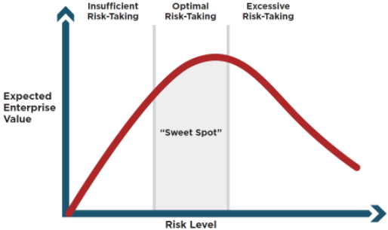
The Risk “Sweet Spot” is a demanding destination . . .

Slide 16
Risk Management Responses

Slide 17
On the journey to Unconscious Competence
 | Conscious | Unconscious
Competent | Smart Player | Instinctive Expert
Incompetent | Anxious Operator | Inadvertent Amateur

Slide 18
Global insights / Personal insights
2.

Slide 19
Quick Brainstorm
What are the biggest strategic risks
currently facing every organisation?
Provide a brief description in the Chat-box
(Try not to repeat suggestions from others)

Slide 20
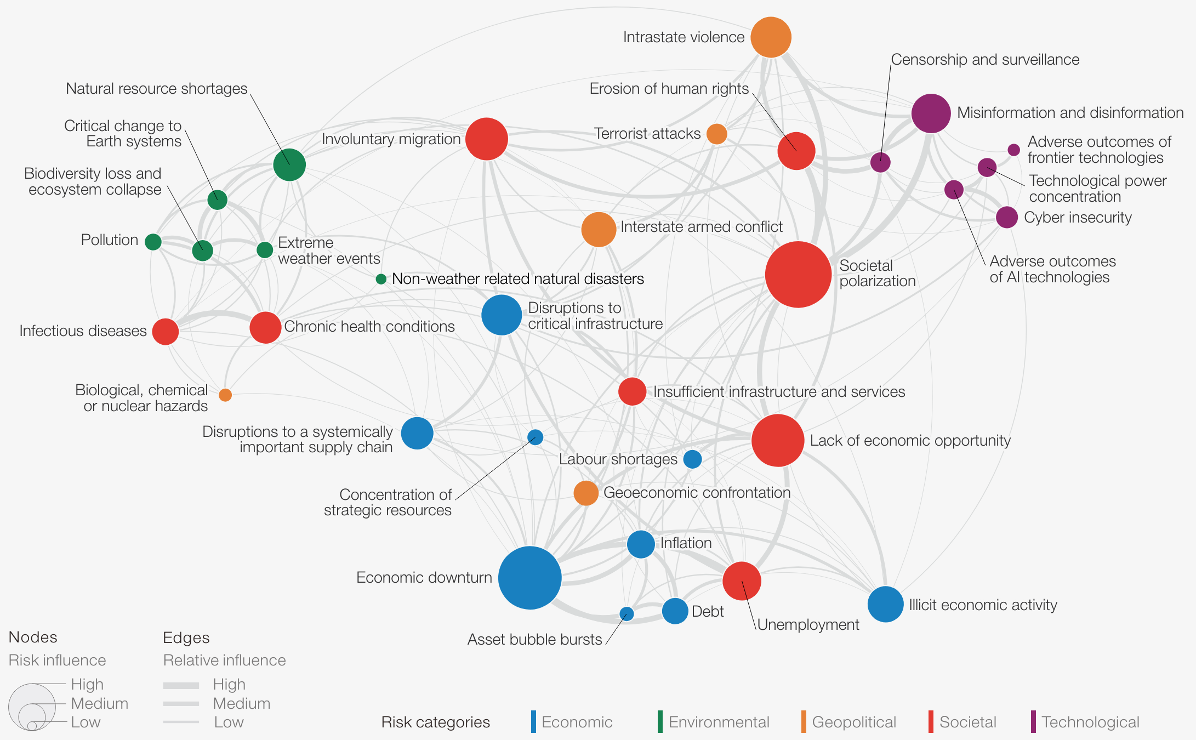
Summary of World Economic Forum Risks (January 24)

Slide 21
Summary of Risks reported by global Enterprise Agencies*
Climate change impacts on trade, green transition challenges Credit risk from supported companies Currency fluctuations affecting exports Cybersecurity threats Declining foreign investment attractiveness Digital transformation challenges Economic recovery post-COVID Economic sanctions, shocks and policy stagnation Economic slowdown, uncertainty and inflation Environmental sustainability pressures Exchange rate volatility Export market risks Financing risks for startups Geopolitical instability, tensions Global competition, trade tensions (and tariffs), volatility, downturn Impact of Brexit on trade relations
Global competition, trade tensions (and tariffs), volatility, downturn Impact of Brexit on trade relations Increased competition for inward investment Inflation and interest rate increases Infrastructure challenges Insufficient resources to engage businesses Limited access to export markets Political and regulatory instability Retention of specialist resources Rising costs for SMEs Rising costs of transportation Rising energy prices Risk capital market downturn Supply chain challenges, disruptions, vulnerabilities (incl. post Covid) Sustainability challenges Talent and skills gaps
* - summarised by GPT4o

Slide 22
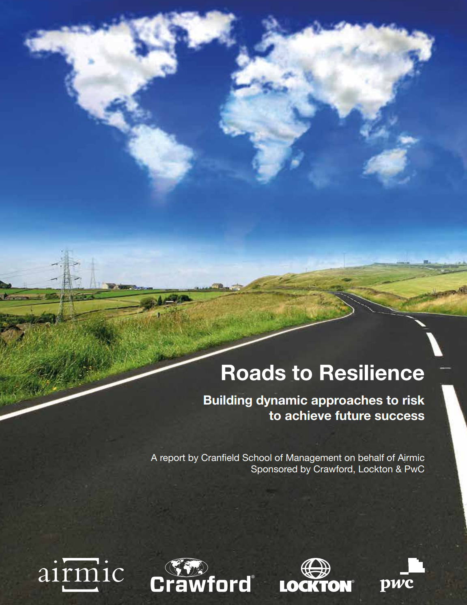
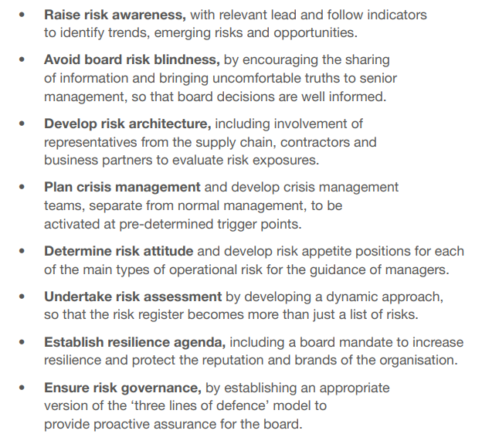
Roads to Ruin . . . warning signs for all Board Members
Board Skill and NED Control
Board Risk Blindness
Leadership on Ethos and Culture
Defective Internal Communication
Risks from Organisational Complexity and Change
Risks from Incentives
“Risk Glass Ceiling”
Roads to Ruin - A study of major risk events: their origins, impact and implications
Cass Business School

Slide 23
Cognitive biases: Beware!!
Mindless taking of the first step
Dehumanisation of others
De-individuation of self (anonymity)
Diffusion of personal responsibility
Blind obedience to authority
Uncritical conformity to Group Norms (‘Groupthink’)
Passive tolerance of evil through inaction or indifference
The Lucifer Effect: understanding how good people turn evil
Philip Zimbardo

Slide 24
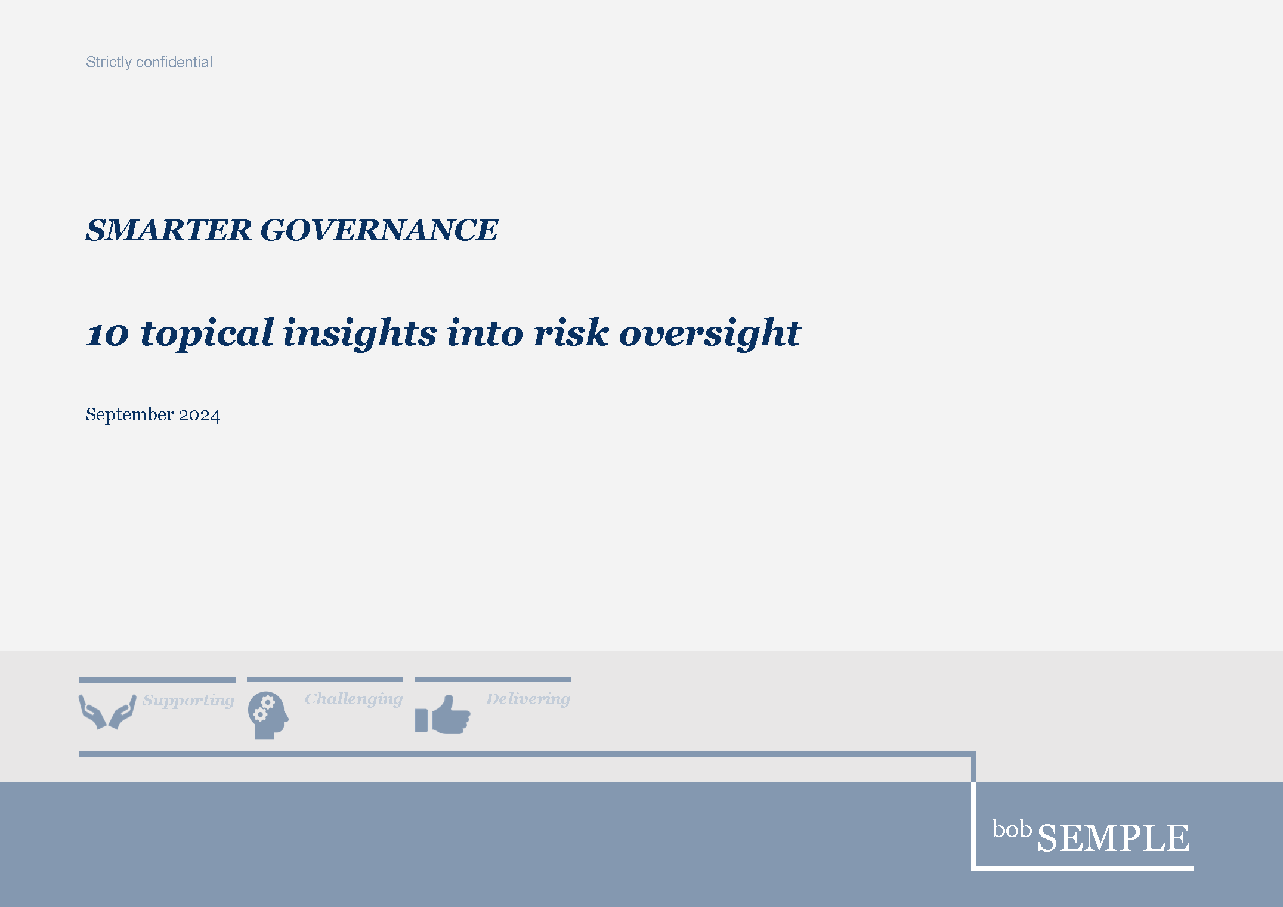
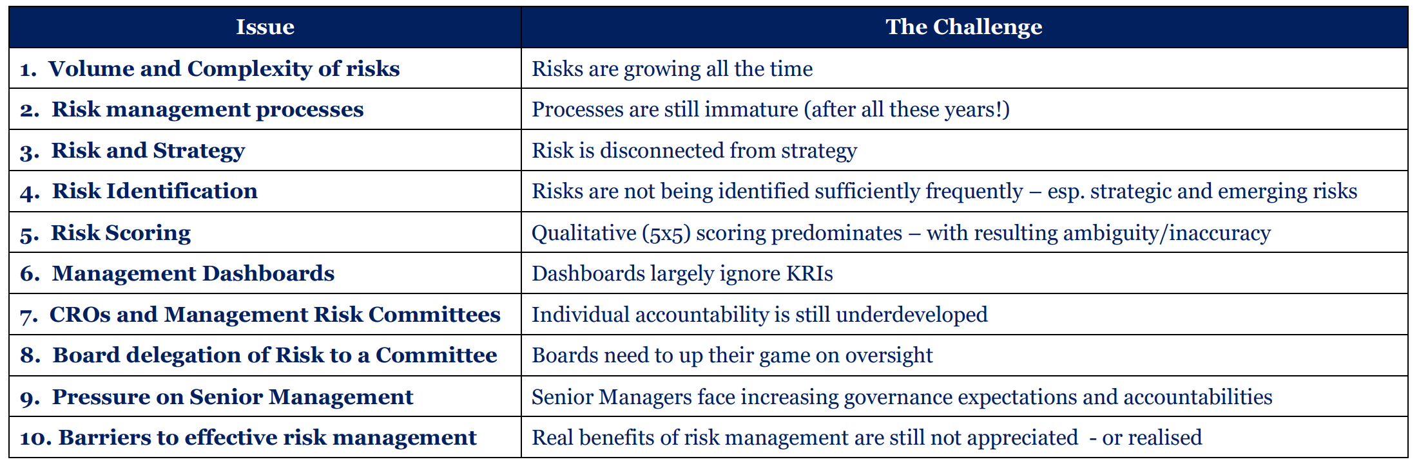

Slide 25
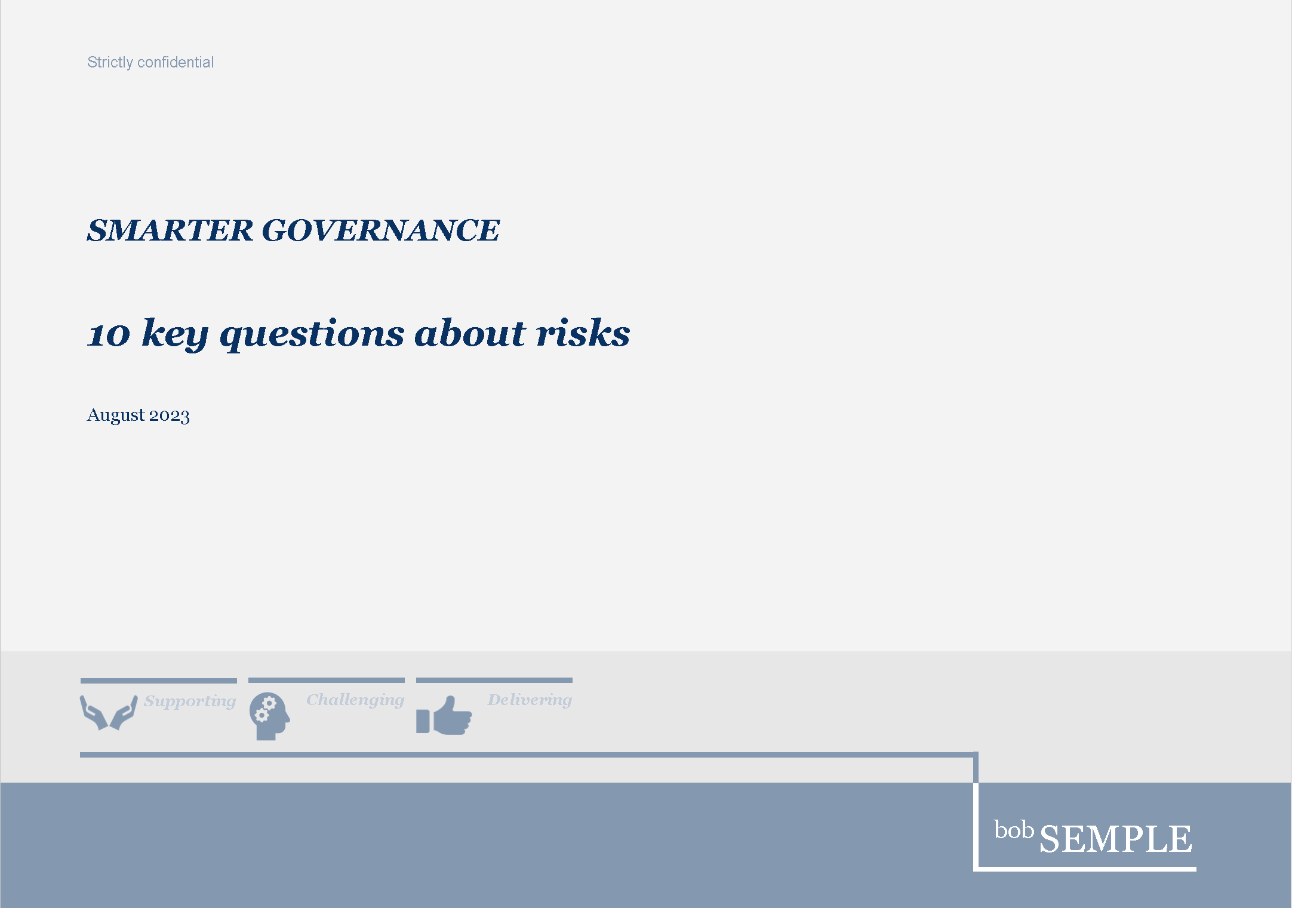
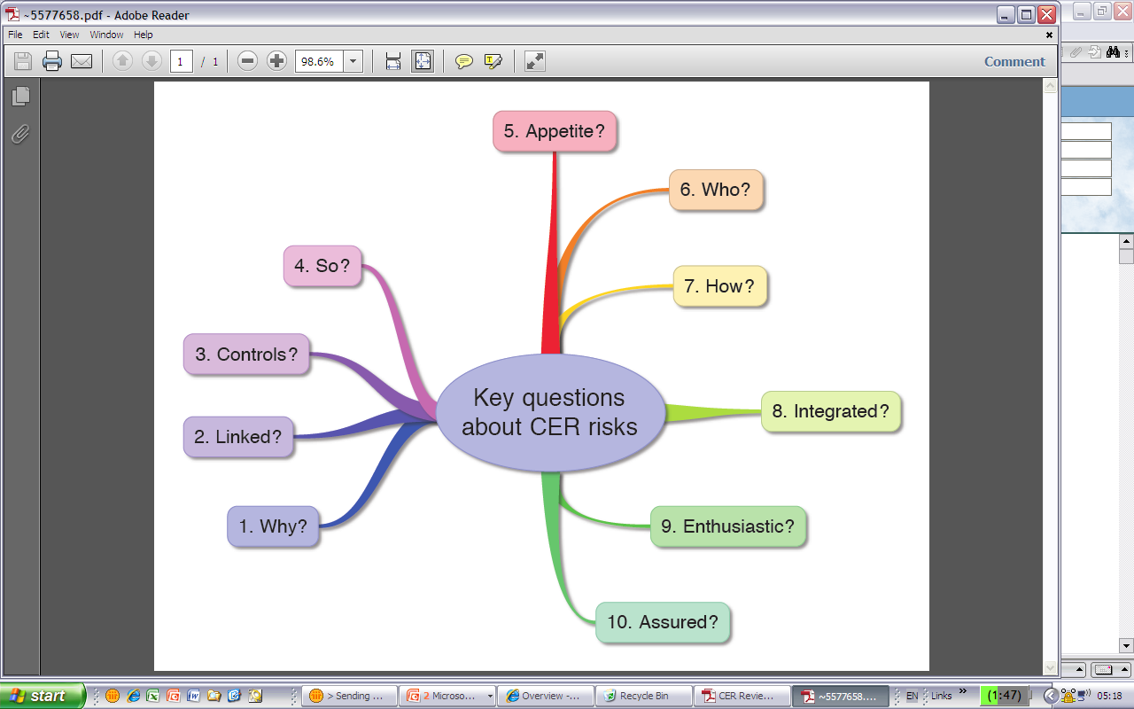
10 questions

Slide 26

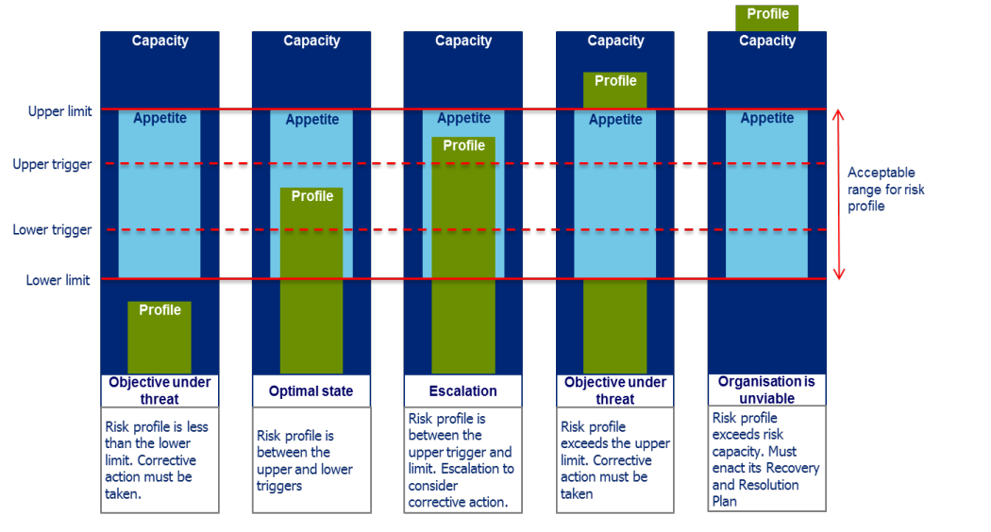
Refining the Board’s definition of Risk Appetite

Slide 27
Risk Appetite Statement – definitions

Slide 28
Insights from Case Studies
BP Deep Water Horizon
VW DieselGate
Equifax
Wells Fargo
Lehmann Brothers
Boeing
Cambridge Analytica
UK Post Office

Slide 29
Insights from Risk Case Studies
Organisation | Key insight
BP Deep Water Horizon | Prioritising cost-cutting and speed over safety; insufficient fail-safes
VW DieselGate | Culture promoting market dominance; tolerance of (/blindness to) systematic deception
Equifax | Inadequate cybersecurity practices/delayed patching – disregard for personal data
Wells Fargo | Aggressive sales targets/incentives; toxic culture encouraged fraudulent account creation
Lehmann Brothers | Excessive leverage/ overreliance on short-term funding ; underestimating systemic risks
Boeing | Racing to launch 737 MAX, downplaying safety and minimizing regulatory oversight
Cambridge Analytica | Poor ethical data governance/privacy controls – resulting in huge misuse of personal data
UK Post Office | Blind trust on Horizon IT system and aggressive prosecution of sub-postmasters

Slide 30
Practical Questions
4.

Slide 31


Slide 32


Slide 33
Good risk questions
What risks do we seek to take and why? What risks do we want to avoid and why?
Which uncertainties in our business model do we need to understand (better)?
What risks inherent in our business model must be reduced to an acceptable level
and over what time horizon (i.e. what level of risk we are willing to take?)
What risks could we manage better?
What future developments or emerging risks could alter the assumptions underlying our strategy?
How do we want to do business (i.e. how do we communicate internally and externally the organisation’s commitment to responsible business behaviour)?

Slide 34
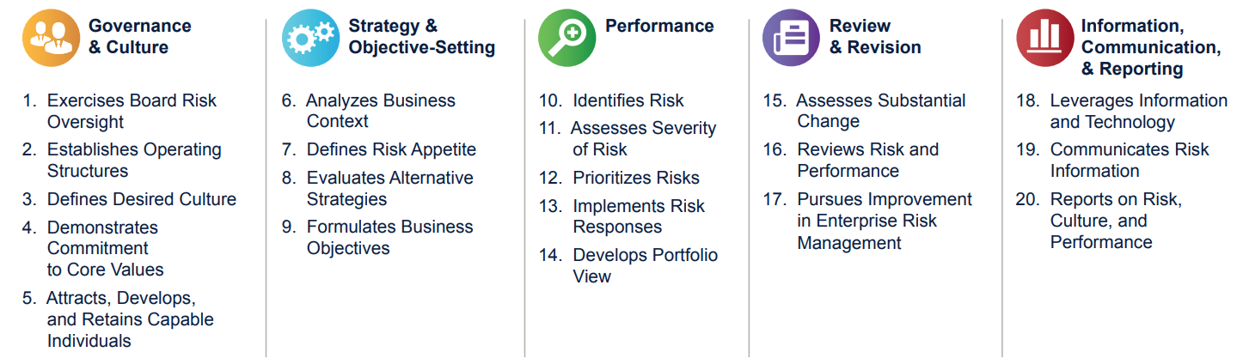
Typical opportunities to enhance management of risks
Develop a shared, explicit understanding of Risk Appetite
(in place of individual, implicit understanding)
Embed risk management
in day-to-day operations
Encourage application of
‘SMART’ to proposed actions
Pay more attention to risk velocity
and emerging risk
Get a new
risk management system
Sharpen up Board responsibilities
(v. delegated responsibilities)
Increase review /
challenge by Board
and by Senior Management
Put a major focus
on actions
to mitigate risks
Integrate risk tightly
with Strategic Plan
Improve reporting
of top risks
Promote a culture of
continuous improvement
(displacing any residual ‘culture of blame’)
Learn from incidents
and ‘near misses’
Improve assessment of
impact/probability

Slide 35
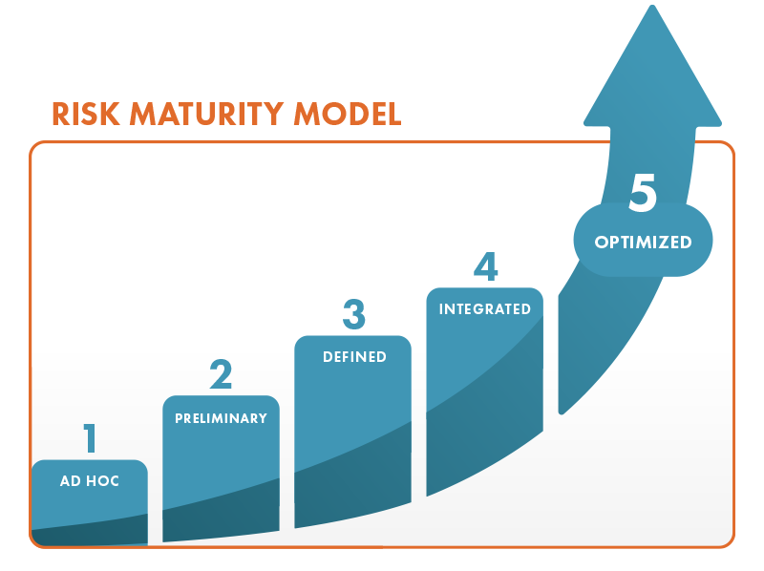
Risk Management Maturity?

Slide 36
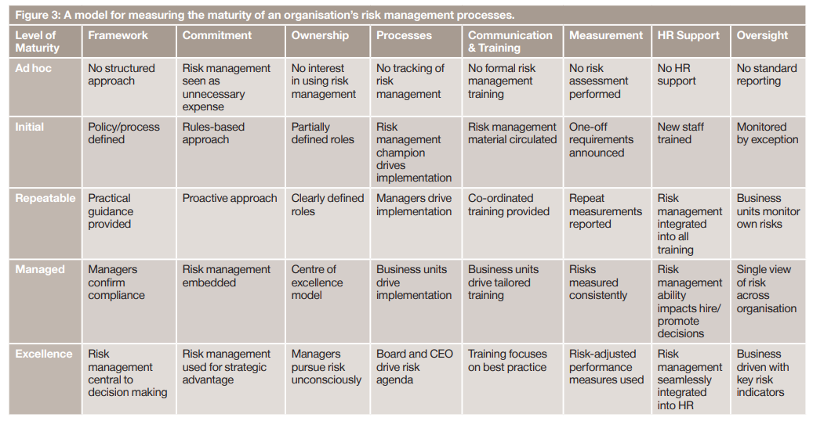
Risk Management Maturity Model

Slide 37
Agenda
A recap on the basics
Global Insights / Personal Insights
Case Study
Practical Questions

Slide 38
The 4 Assurances Board Members must seek
Can you assure the Board that you:
have an up-to-date (complete) listing of the top risks facing the organisation?
have action plans to address them appropriately
(aligned with our risk appetite)?
are implementing those actions on a timely basis?
have told us anything else we need to know about risks?
(addressing risk velocity, emerging risks etc)

Slide 39


Slide 40
“A good plan, violently executed now, is better than a perfect plan next week”
General Patton, US Army

